Slide 1

ELectricpy
A Python module for Electrical Engineers

Slide 2




Background and objectives
Python summary and goals for electricpy
Python’s Growing Popularity in Data Science and Analytics
Python’s General-Purpose Nature and Ability to Integrate with other Systems
Used by more than 65% of Data Scientists According to 2018 Software Polls*
Python’s Open Support for Numerical Analysis Tools
NumPy
SciPy
SymPy
MatPlotLib
NumDiffTools
Provide a Platform Similar to NumPy and Others to Handle Electrical Engineering
Function Syntax and Documentation
Simple and Common Functions
Advanced Formulas Necessary for Complex Operations
*[KDnuggets]

Slide 3

Related work and similar modules
Preexisting Electrical Eng. modules in python
Power System Analysis and Modeling
PYPOWER*: Ported from Matlab’s MATPOWER
PyPSA**: NumPy and PANDAS Power System Analysis Tool
PandaPower†: PANDAS Based Complete Modeling and Analysis Tool
Additional Modeling and Analysis Tools
Python Comtrade‡: NumPy Based Comtrade File Interpreter
BMS•: NumPy Based Block Model Simulator
SimuPy₣: NumPy Based System Simulator
*[PYPOWER], **[PyPSA], †[PandaPower], ‡[Python Comtrade], •[BMS], ₣[SimuPy]

Slide 4
Module development
Development drivers and summary
Started as EESIGNAL and EEPOWER (Began Early Fall 2018)
Developed to Support Basic Concepts and Cross-Functionality for Analysis
No Published or Publicly Available Code
Courses that Spurred Development: ECE-450 (Sullivan), ECE-528 (Ortmann)
Modularized and Published as ELECTRICALPYTHON
Constituted Submodules EESIGNAL and EEPOWER
Complex Module References Between Submodules and Supporting Files
Inconsistent Documentation and Formatting
Ongoing Course Encouragement: ECE-476 (Sullivan), ECE-529 (Johnson)
Re-Formatted, Condensed, and Re-Published as ELECTRICPY
Consistent Variable Naming Used Throughout
Standard Pythonic Documentation Constraints Applied
Significant Reduction of Module-Cross References
Ongoing Course Encouragement: ECE-523, -524, -525 (Johnson), ECE-522 (Law)

Slide 5
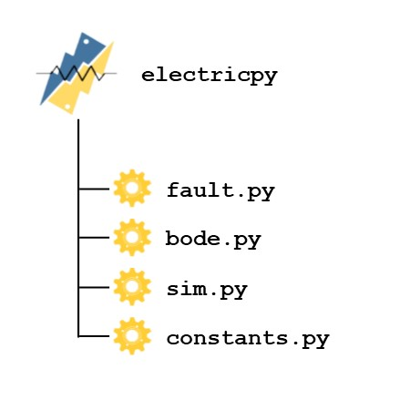
Module structure
Pythonic structure built for simplicity
Common and Standard Functions Contained in Primary Module: ELECTRICPY
Phasor Functions
RMS and Standard Circuit Divider Functions
Fast Fourier Transform Function Wrappers
Additional Common Display and Formatting Functions
Induction Machine Formulas
Symmetrical Component Functions
Consistent Variable Notation and Documentation
Variety of Functions Logically Distributed between Submodules
BODE: Submodule Developed for Plotting and Interpreting Bode Plots
FAULT: Submodule Developed for Fault Analysis
SIM: Submodule Developed for Modeling and Simulation
CONSTANTS: A Collection of Constants and Constant Matrices

Slide 6
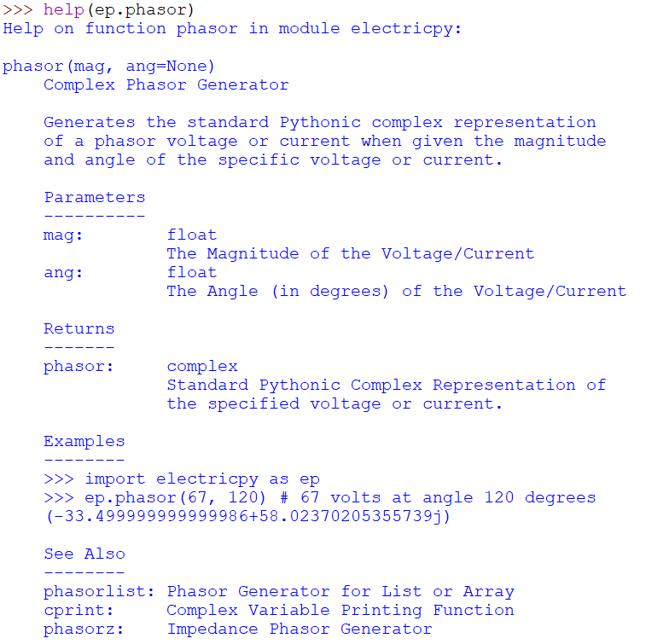
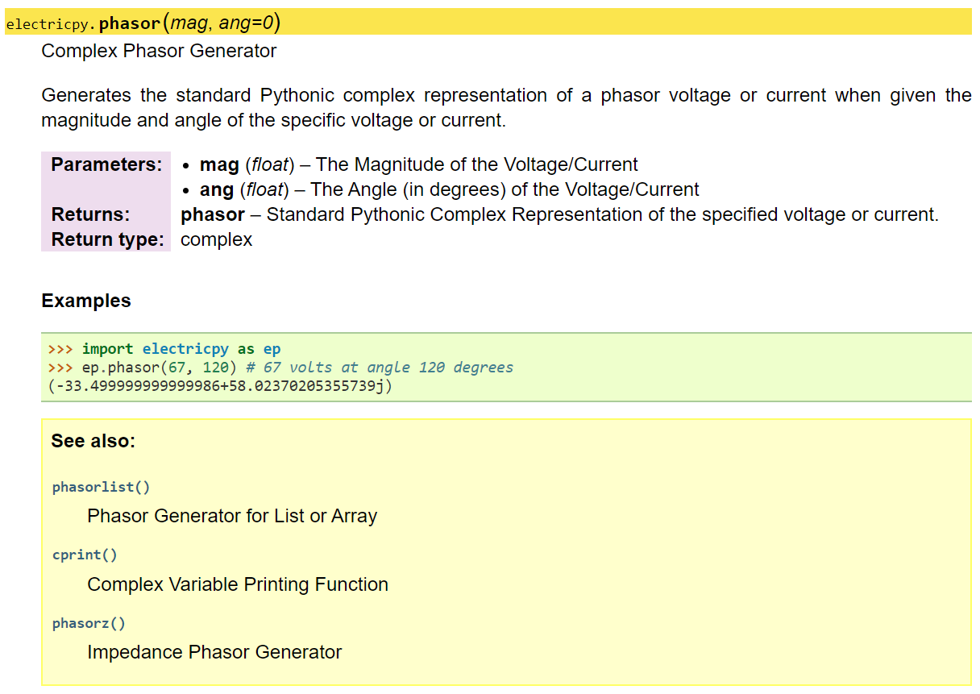
Documentation and resources
Built in documentation and web-based docs
Standard, Built In, Pythonic Documentation in Docstrings
Consistent Function Summaries
Consistent Variable Naming
Consistent Arithmetic Formula Descriptions
Consistent Online Web Documentation Built from Docstrings
Full Module Documentation and Function Descriptions
Descriptions Separated Logically by Submodule
Full Arithmetic Formula Descriptions in “Pretty” LaTeX Format
Similar Function Links to Support Quick Support
Fully Searchable Pages to Enable Users to Find Results Fast

Slide 7
Simple Demo
Simple operations with electricpy in python

Slide 8
Questions?
Thank you for your time

Slide 9
references
[KDnuggets] – “Python Eats Away at R: Top Software for Analytics, Data Science, Machine Learning in 2018: Trends and Analysis”, KDnuggets, Available online at: https://www.kdnuggets.com/2018/05/poll-tools-analytics-data-science-machine-learning-results.html
[PYPOWER] – Python Module, “a power flow and Optimal Power Flow (OPF) solver.”, Available online at: https://pypi.org/project/PYPOWER/
[PyPSA] – Python Module, “a free software toolbox for simulating and optimising modern power systems”, Available online at: https://github.com/PyPSA/PyPSA
[PandaPower] – Python Module, “An easy to use open source tool for power system modeling, analysis and optimization with a high degree of automation.”, Available online at: https://www.pandapower.org/
[Python Comtrade] – Python Module, “a module for Python 3 designed to read Common Format for Transient Data Exchange (COMTRADE) files.”, Available online at: https://github.com/dparrini/python-comtrade
[BMS] – Python Module, “a block model time simulator”, Available online at: https://pypi.org/project/bms/
[SimuPy] – Python Module, “a framework for simulating interconnected dynamical system models”, Available online at: https://pypi.org/project/simupy/

